Slide 1
Classifying Chaotic Synthesizers with a Multimodal Neural Network
Landon Buell
4 Dec 2020

Slide 2
Let’s Play a Game
What made the sound being played?

Slide 3

Name the Source of the Sound
Example 1:
Violin – G4
Example 2:
Guitar – B2
Example 3:
Clarinet – G#5
Example 4:
Triangle Wave – 220 Hz
Example 5:
French Horn – C#4
Example 6:
Oboe – Bb4

Slide 4
How do you Know?
Humans good at mapping sounds to sources
Can we “teach” a computer to do it?
Practical Example: Classifying Synthesizers

Slide 5
The Neural Network
Introduction / Function / Training

Slide 6
Neural Network?
“Birds inspired us to fly, burdock plants inspired velcro and nature has inspired many other inventions. It seems only logical, then, to look to the brain’s architecture for inspiration on how to build an intelligent machine.”
- Aurelion Geron, Former Youtube Video Classification lead

Slide 7
What is a Neural Network?
A Neural network is a mathematical function
Composed of Layers, with “trainable” Parameters
Transform an Input Array into an Output Array

Slide 8
A Classification Model
We map a set of inputs to a qualitative output
We seek to “group” similar inputs
Place them into 1 of K classes
This model is called a classifier

Slide 9
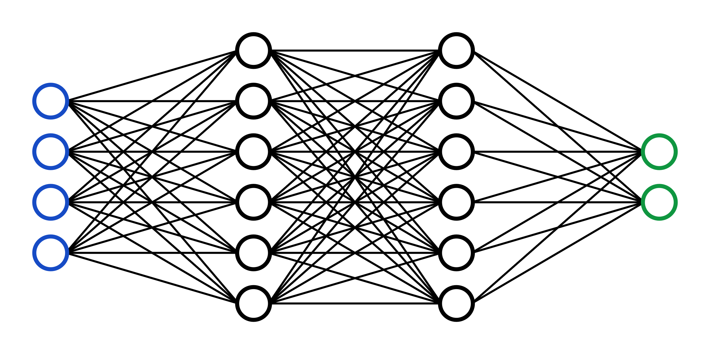
Making Predictions
Input is transformed through repeated calling of layer functions
The output of final layer is the network’s “prediction”
Encode output as a probability distribution over the classes

Slide 10
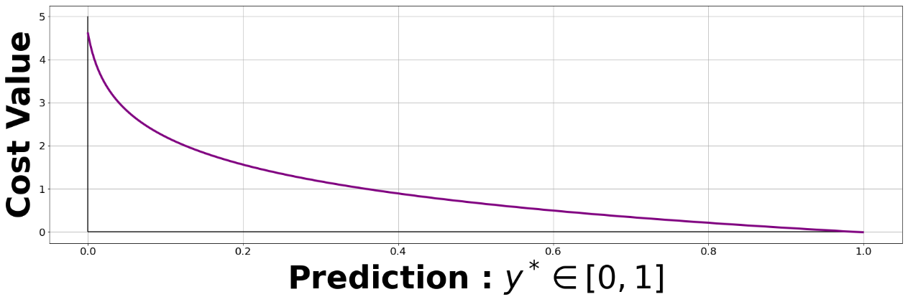

Training A Network
Provide the model with labeled training samples
The model makes a prediction
For an untrained network, this is likely to be very poor
We quantify the error with an Objective Function
Categorical Cross Entropy
$$CXE\left[y,y^{∗}\right]= \sum_{i=0}^{K−1}{y_{i}log⁡(y_{i}^{∗})}$$

Slide 11
Optimization
Choose parameters to minimize the objective function
We do not “train” a neural network
We Optimize a Neural Network

Slide 12

Optimization (Cont.)
“Adaptive-Moments” Optimizer
Powerful, Robust, Stable
Adjust each parameter to minimize cost function
Based on Gradient Descent
Compute gradient w.r.t cost function

Slide 13
Features Used
Spectrogram / Time-Series / Frequency Series

Slide 14
Why Features?
“The data reduction stage which is also called feature extraction, consists of discovering a few important facts about each class. The choice of features is critical as it greatly affects the accuracy of audio classification.”
- M. Kashif Saeed Khan , Machine Learning Researcher
Features are inputs that we provide to the neural network

Slide 15
How are Features Chosen?
“For recognition algorithms, the necessary property of the acoustic features is low variability among features extracted from examples assigned to the same class, and at the same time high variability allowing distinction between features extracted from examples assigned to different classes”
- Tuomas Virtanen, Machine Learning & Audio Engineer

Slide 16
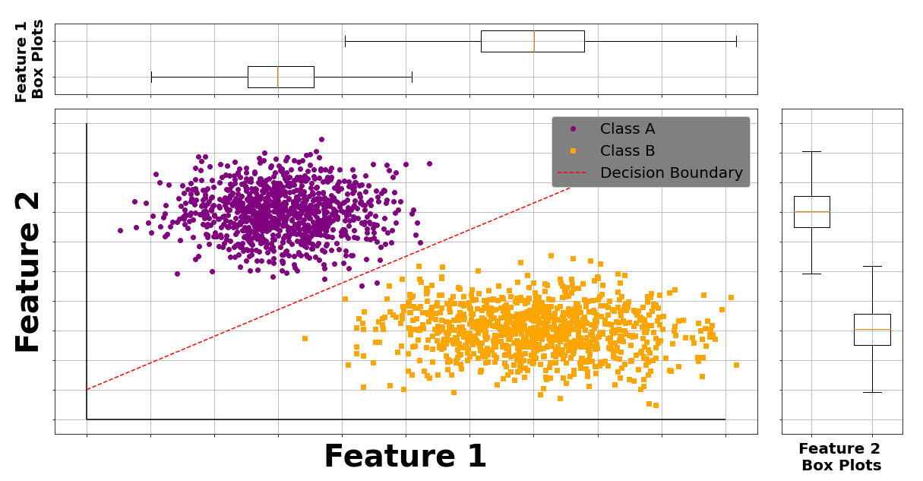
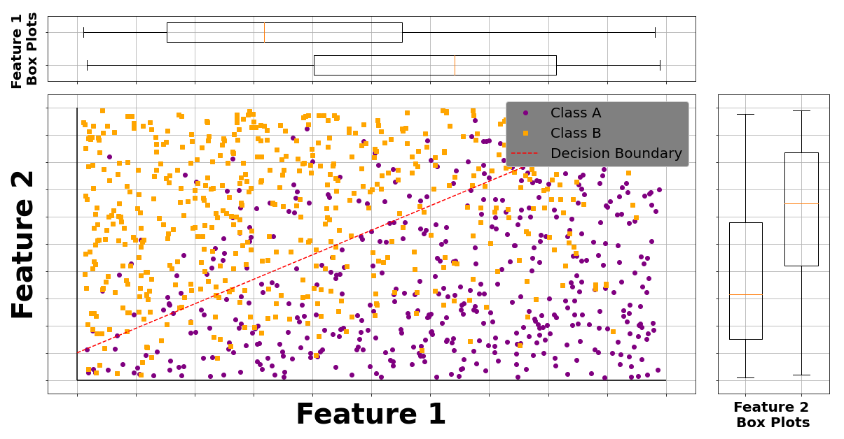
Decision Boundaries
Linear Separable
Linear Non-Separable

Slide 17
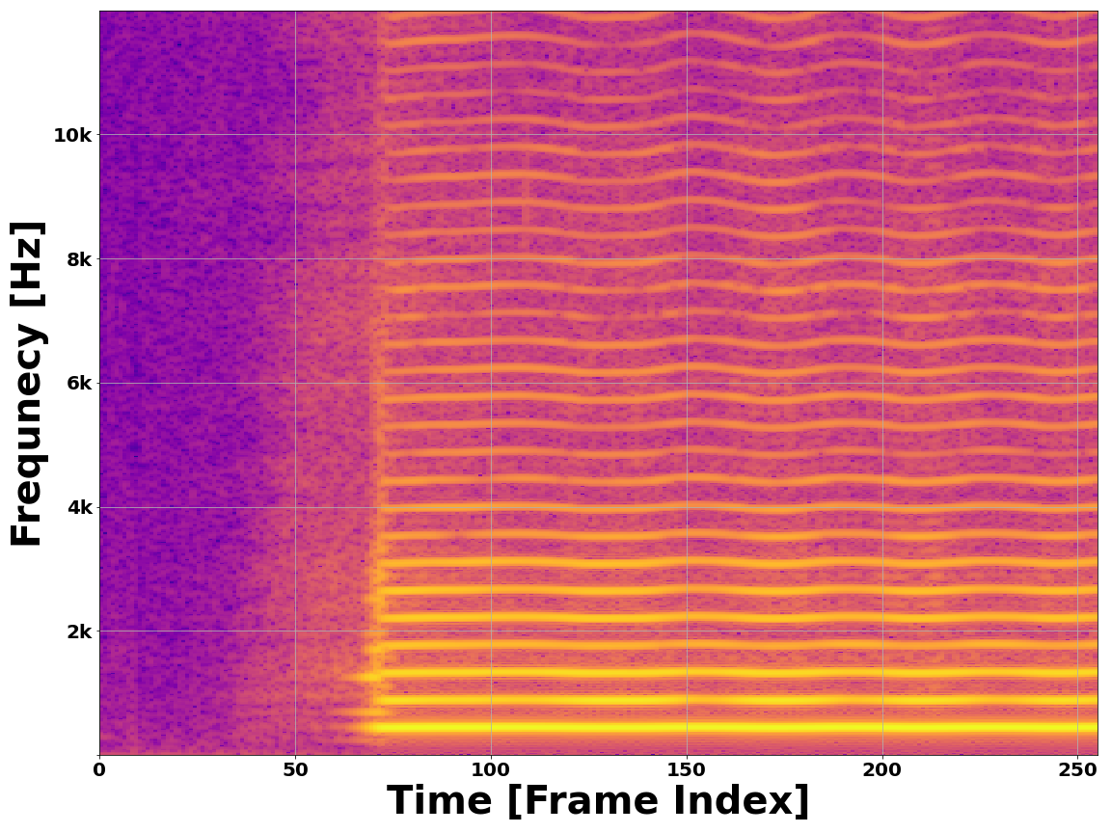
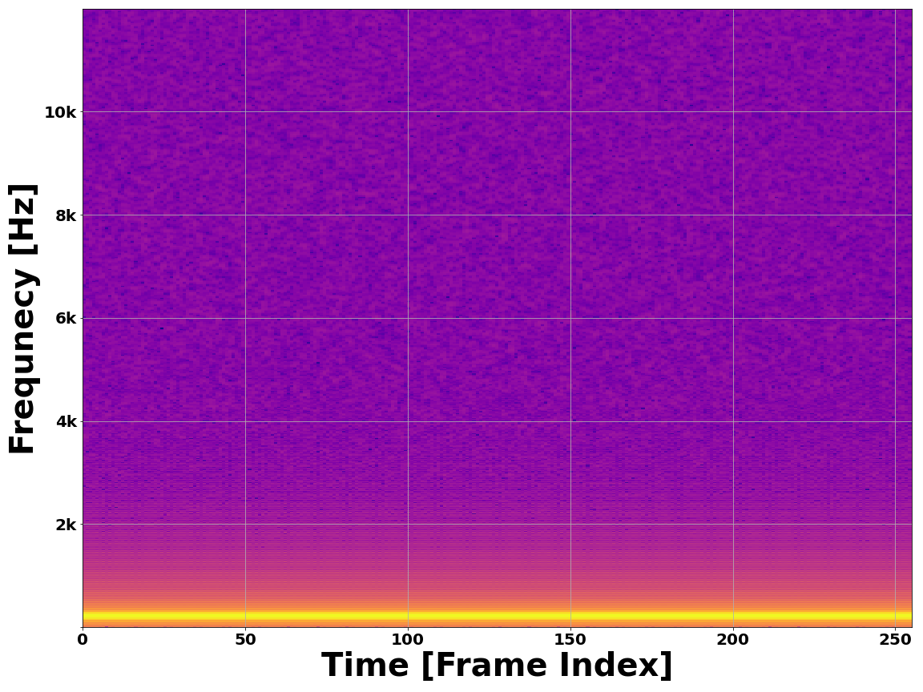
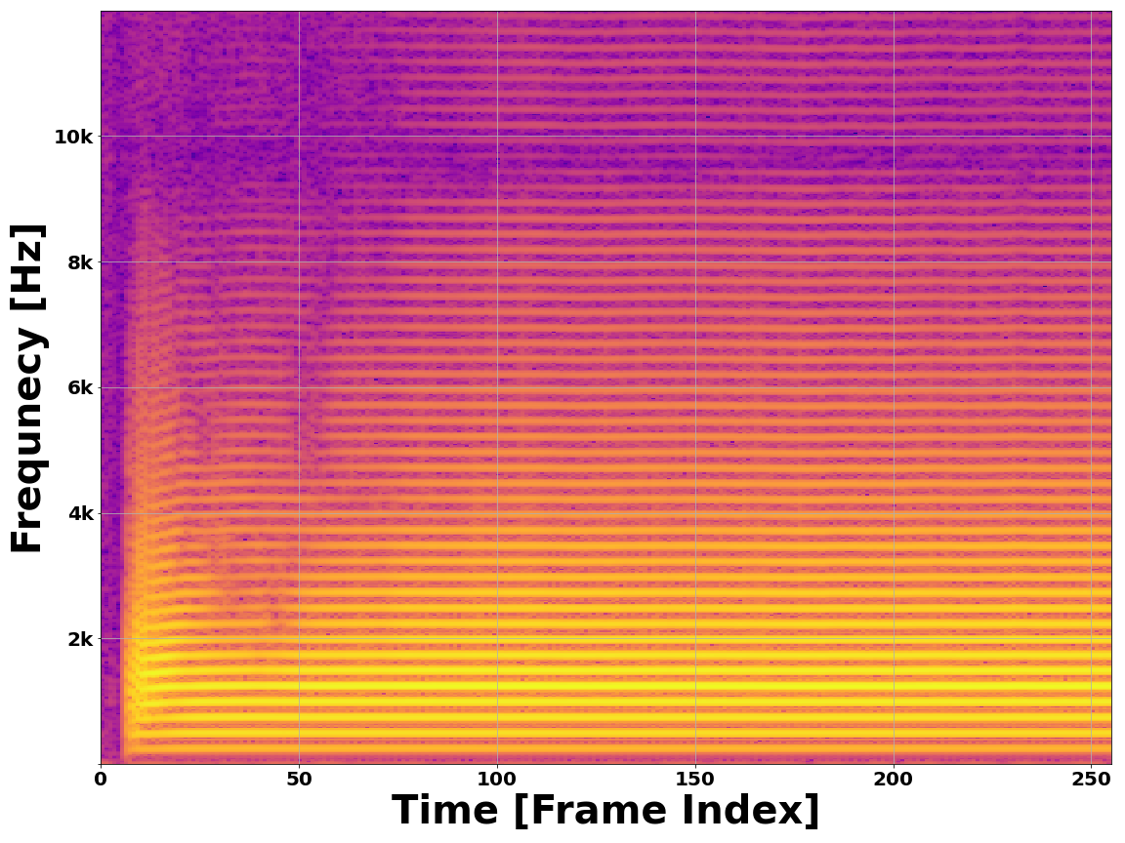
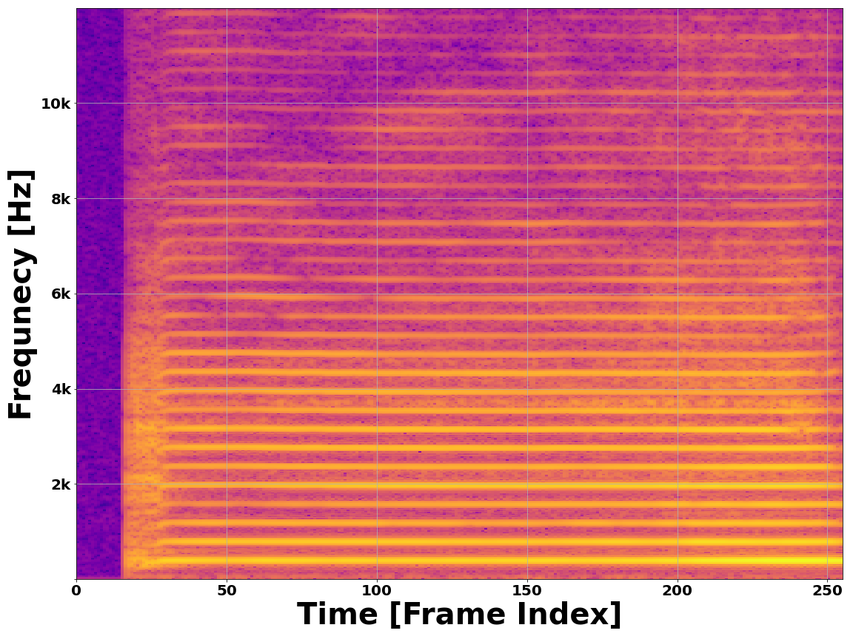
The Spectrogram
Provides a 2D image-like representation of a waveform
Maps energy over frequency and time
Time passes on X-axis
Frequency on Y-axis
Alto Saxophone – A4
Pure Sine – 220 Hz
Bb Trumpet – B3
Violin – G4

Slide 18
Time–Space Features
Time Domain Envelope (x5)
Zero Crossing Rate
Divide waveform into 5 sections
Approximated energy time domain
Compute TDE for each, use as features
Number of times a waveform crosses equilibrium
Identifies Jagged vs. periodic waveforms

Slide 19
Time-Space Features (Cont.)
Temporal Center of Mass
Auto Correlation Coefficients (x4)
Treat waveform as 1D mass-distribution
Short sustains vs. long sustains
Dotting a signal to a time-delayed version of itself
Useful for detecting periodicity

Slide 20
Frequency-Space Features
Mel Frequency Cepstrum Coefficients
Frequency Center of Mass
Detect periodicity in frequency spectrum
Computed using Mel Filterbank Energies
Dot the frequency spectrum with overlapping triangular filters
Treat frequency spectrum as 1D mass distribution
Lower Instruments vs. Higher Instruments

Slide 21
Network Architecture
What do we do with our features?

Slide 22
Dual Modalities
2D Spectrogram vs. 1D Feature Vector
Two modes – convey the same information
Compare to human cardinal senses

Slide 23
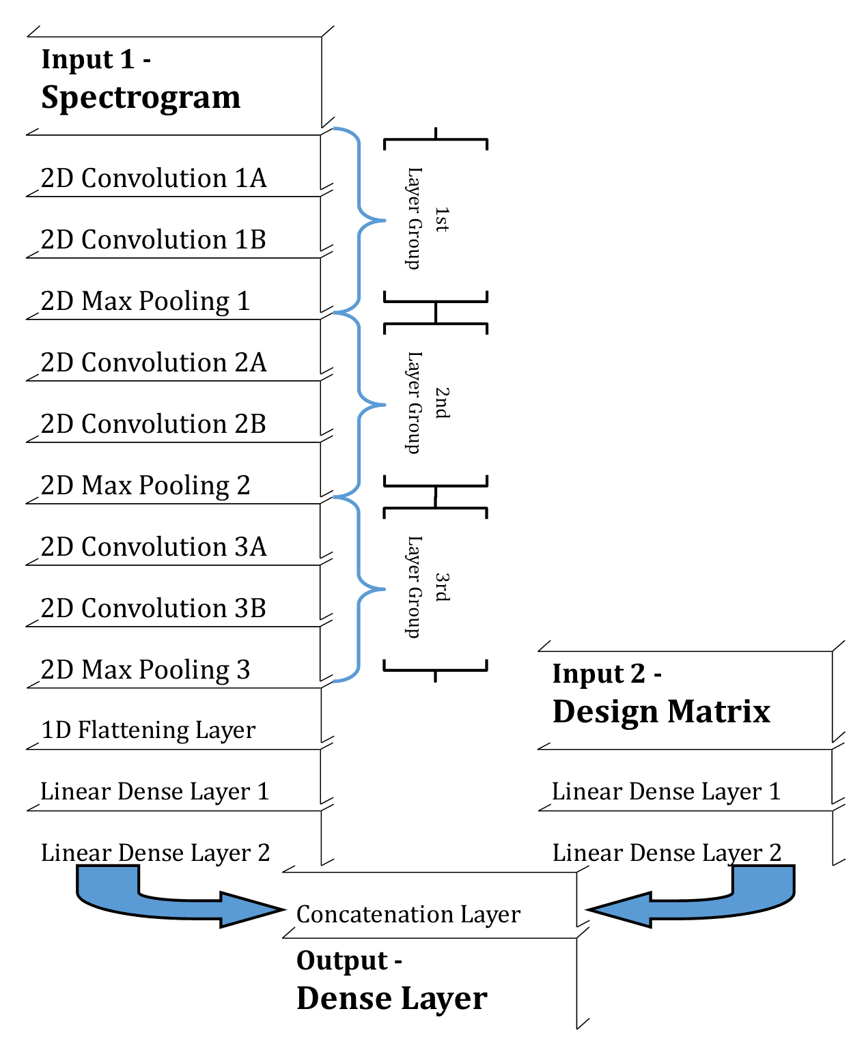
A Hybrid Neural Network
Image is Processed with a Convolutional Neural Network
Vector is Processed with a Mulitlayer Perceptron
Results are Merged to form a single prediction based on both inputs

Slide 24
Does it Work?
Can we trust the model?

Slide 25
Resampling
K – Folds Cross Validation
Train & Test ‘K’ models trained on overlapping subsets of data
Ensures no “anomaly cases”

Slide 26
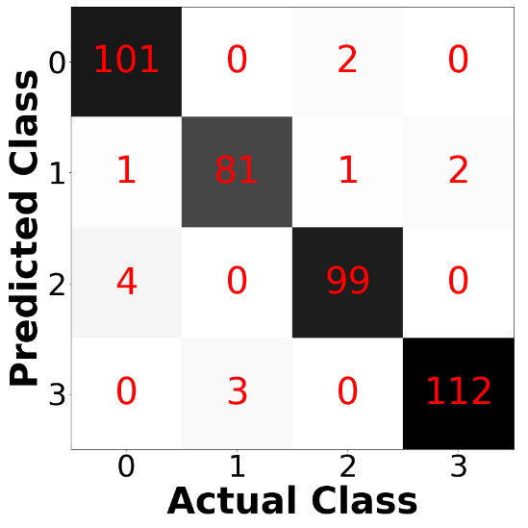
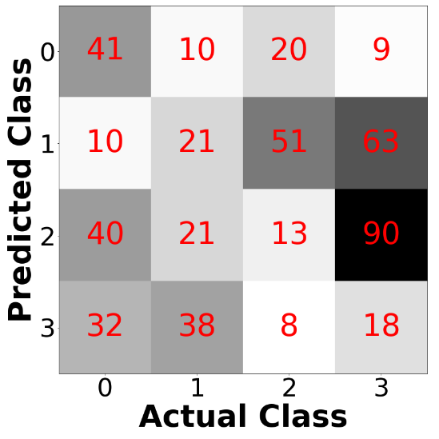
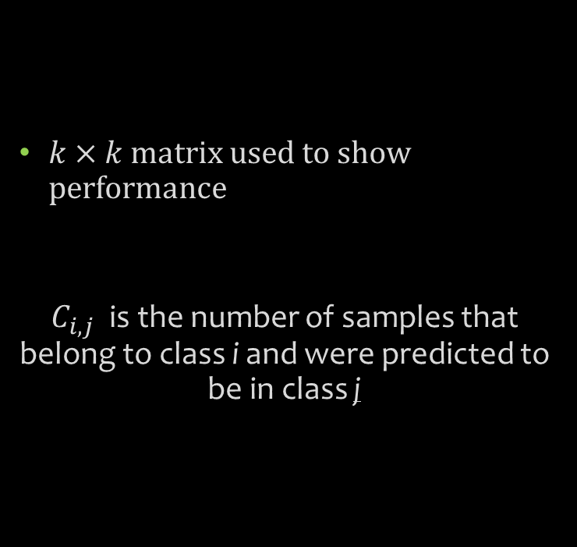
The Confusion Matrix
$k×k$ matrix used to show performance
$C_{i,j}$ is the number of samples that belong to class i and were predicted to be in class j
Diagonal dominance indicates
a stronger model
No diagonal dominance indicates
a weaker model

Slide 27
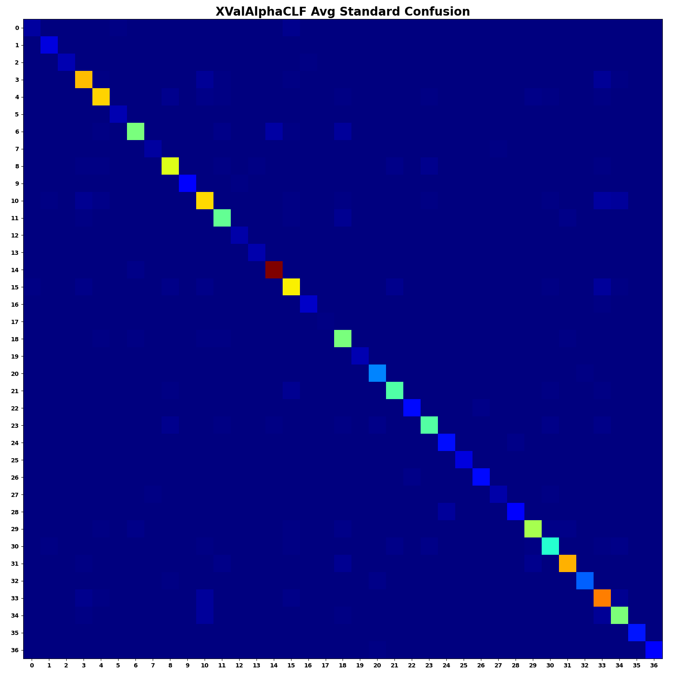
The Standard Confusion Matrix
Averaged over K=10 Folds Cross Validation

Slide 28
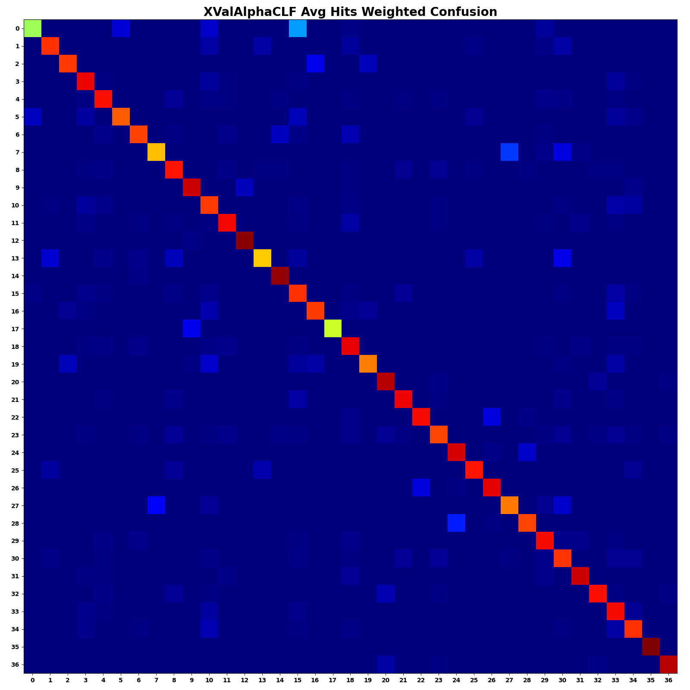
The Hits Weighted Confusion Matrix
Averaged over K=10 Folds Cross Validation
Account for occurrence of each class

Slide 29
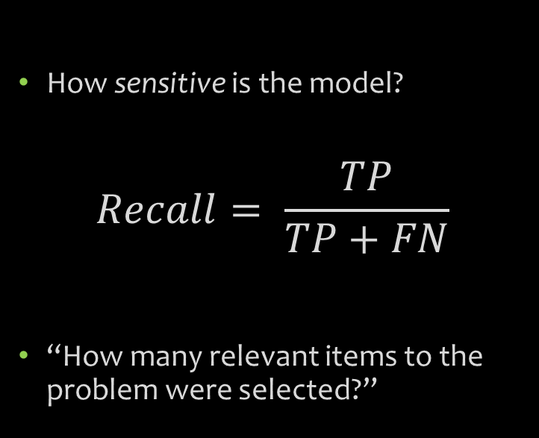
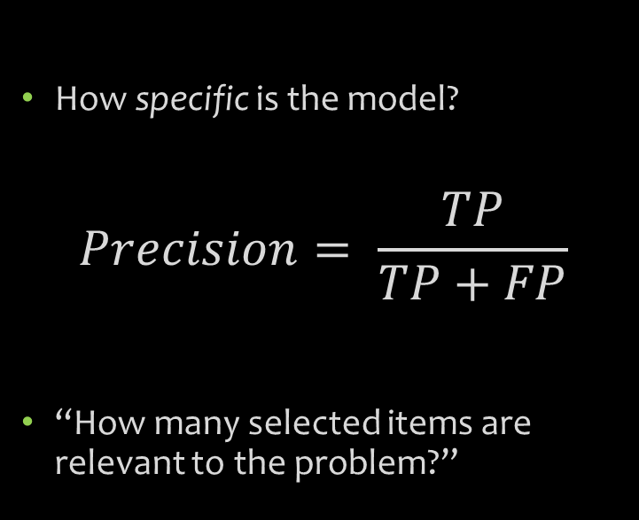
Quicker Metrics
Precision / Specificity Score
Recall / Sensitivity Score
How specific is the model?
$$Precision= \frac{TP}{TP+FP}$$
“How many selected items are relevant to the problem?”
How sensitive is the model?
$$Recall= \frac{TP}{TP+FN}$$
“How many relevant items to the problem were selected?”

Slide 30
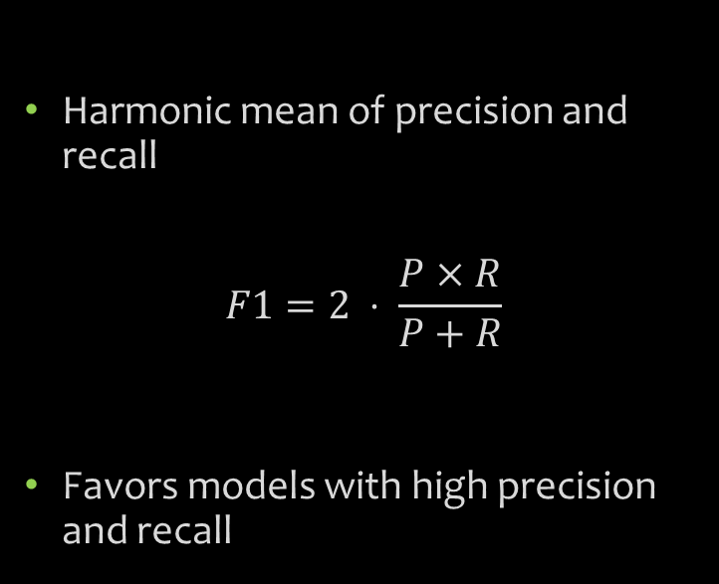
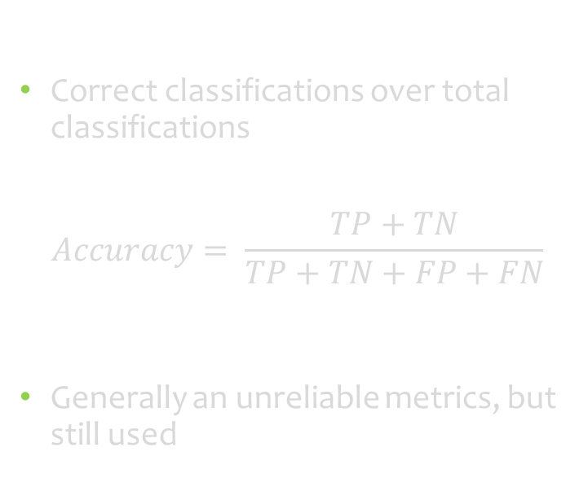
Other Metrics…
Accuracy Score
F1 - Score
Correct classifications over total classifications
$$Accuracy= \frac{TP+TN}{TP+TN+FP+FN}$$
Generally an unreliable metrics, but still used
Harmonic mean of precision and recall
$$F1=2 ⋅ \frac{P×R}{P+R}$$
Favors models with high precision and recall

Slide 31
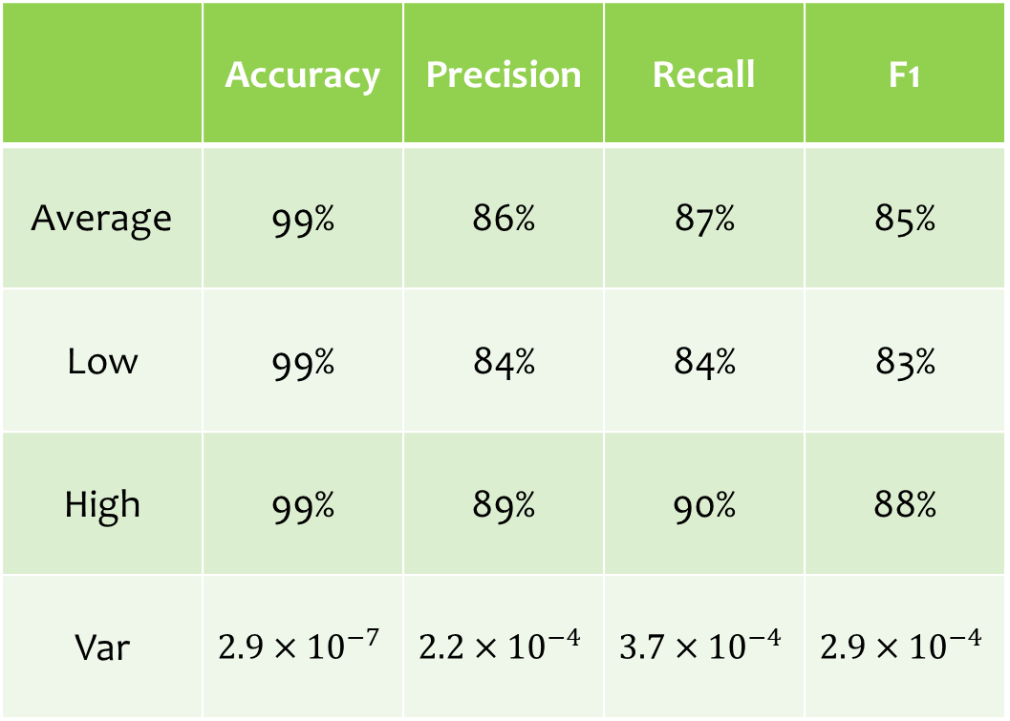
So what?
 | Accuracy | Precision | Recall | F1
Average | 99% | 86% | 87% | 85%
Low | 99% | 84% | 84% | 83%
High | 99% | 89% | 90% | 88%
Var | $$2.9×{10}^{−7}$$ | $$2.2×{10}^{−4}$$ | $$3.7×{10}^{−4}$$ | $$2.9×{10}^{−4}$$
When all is said and Done…
Averaged over 10 folds
Averaged Across 37 classes

Slide 32
Predicting on Unlabeled Synthesizers
Horn – 83% Confidence
Sawtooth Wave – 99%
Oboe – 97% Confidence
Clarinet – 91% Confidence

Slide 33
Questions?
Thank you!

